Slide 1

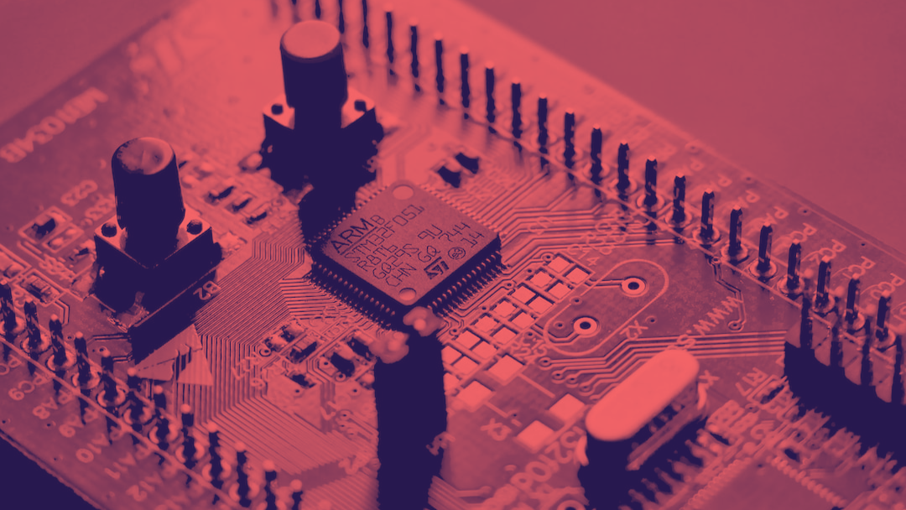
KEYPAD ON MICROCONTROLLER
APLIKASI MIKROKONTROLER
ERIL MOZEF, M. YUSUF FADHLAN
PHYSICAL APPEARANCE

Slide 2
KEYPAD ON MICROCONTROLLER
PHYSICAL APPEARANCE
APLIKASI MIKROKONTROLER
ERIL MOZEF, M. YUSUF FADHLAN

Slide 3
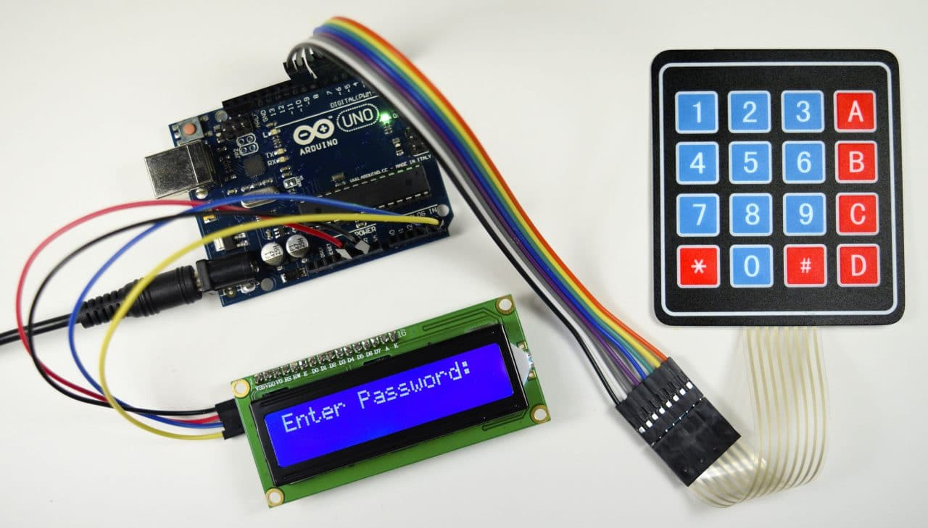
PHYSICAL APPEARANCE
APLIKASI MIKROKONTROLER
ERIL MOZEF, M. YUSUF FADHLAN

Slide 4
PHYSICAL APPEARANCE
APLIKASI MIKROKONTROLER
ERIL MOZEF, M. YUSUF FADHLAN

Slide 5
PHYSICAL APPEARANCE
APLIKASI MIKROKONTROLER
ERIL MOZEF, M. YUSUF FADHLAN

Slide 6

PHYSICAL APPEARANCE
APLIKASI MIKROKONTROLER
ERIL MOZEF, M. YUSUF FADHLAN
INSIDE THE KEYPAD

Slide 7
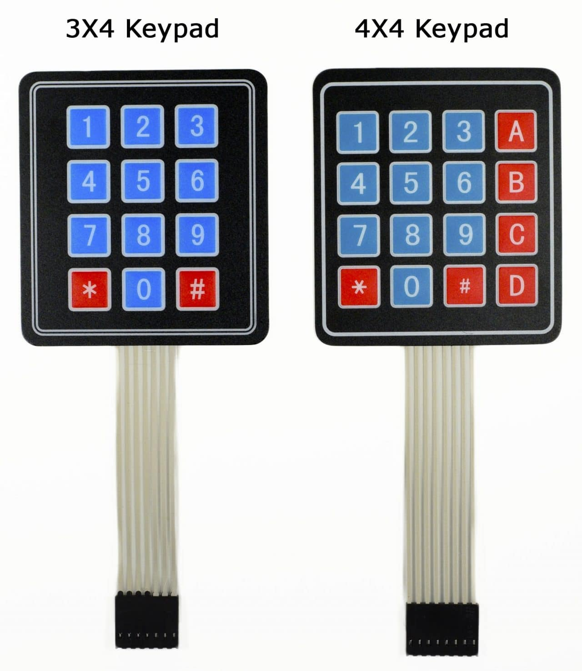
PHYSICAL APPEARANCE
INSIDE THE KEYPAD
APLIKASI MIKROKONTROLER
ERIL MOZEF, M. YUSUF FADHLAN

Slide 8
INSIDE THE KEYPAD
APLIKASI MIKROKONTROLER
ERIL MOZEF, M. YUSUF FADHLAN

Slide 9
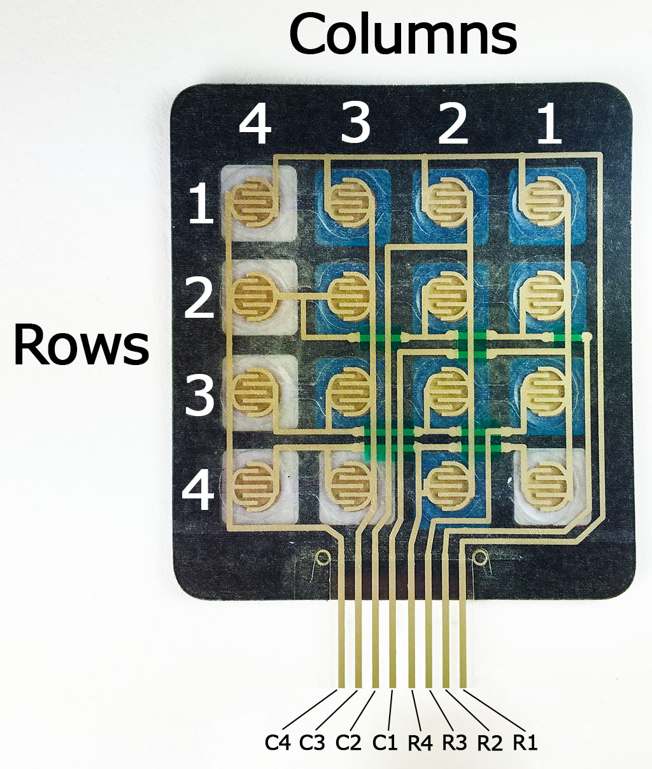
INSIDE THE KEYPAD
APLIKASI MIKROKONTROLER
ERIL MOZEF, M. YUSUF FADHLAN

Slide 10


INSIDE THE KEYPAD
Beneath each key is a membrane switch.
Each switch in a row is connected to the other switches in the row by a conductive trace underneath the pad.
Each switch in a column is connected the same way – one side of the switch is connected to all of the other switches in that column by a conductive trace.
Each row and column is brought out to a single pin, for a total of 8 pins on a 4X4 keypad.
APLIKASI MIKROKONTROLER
myusuffadhlan
ERIL MOZEF, M. YUSUF FADHLAN

Slide 11
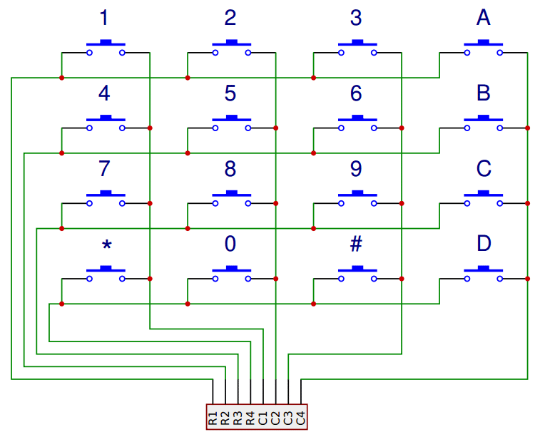
INSIDE THE KEYPAD
APLIKASI MIKROKONTROLER
ERIL MOZEF, M. YUSUF FADHLAN

Slide 12
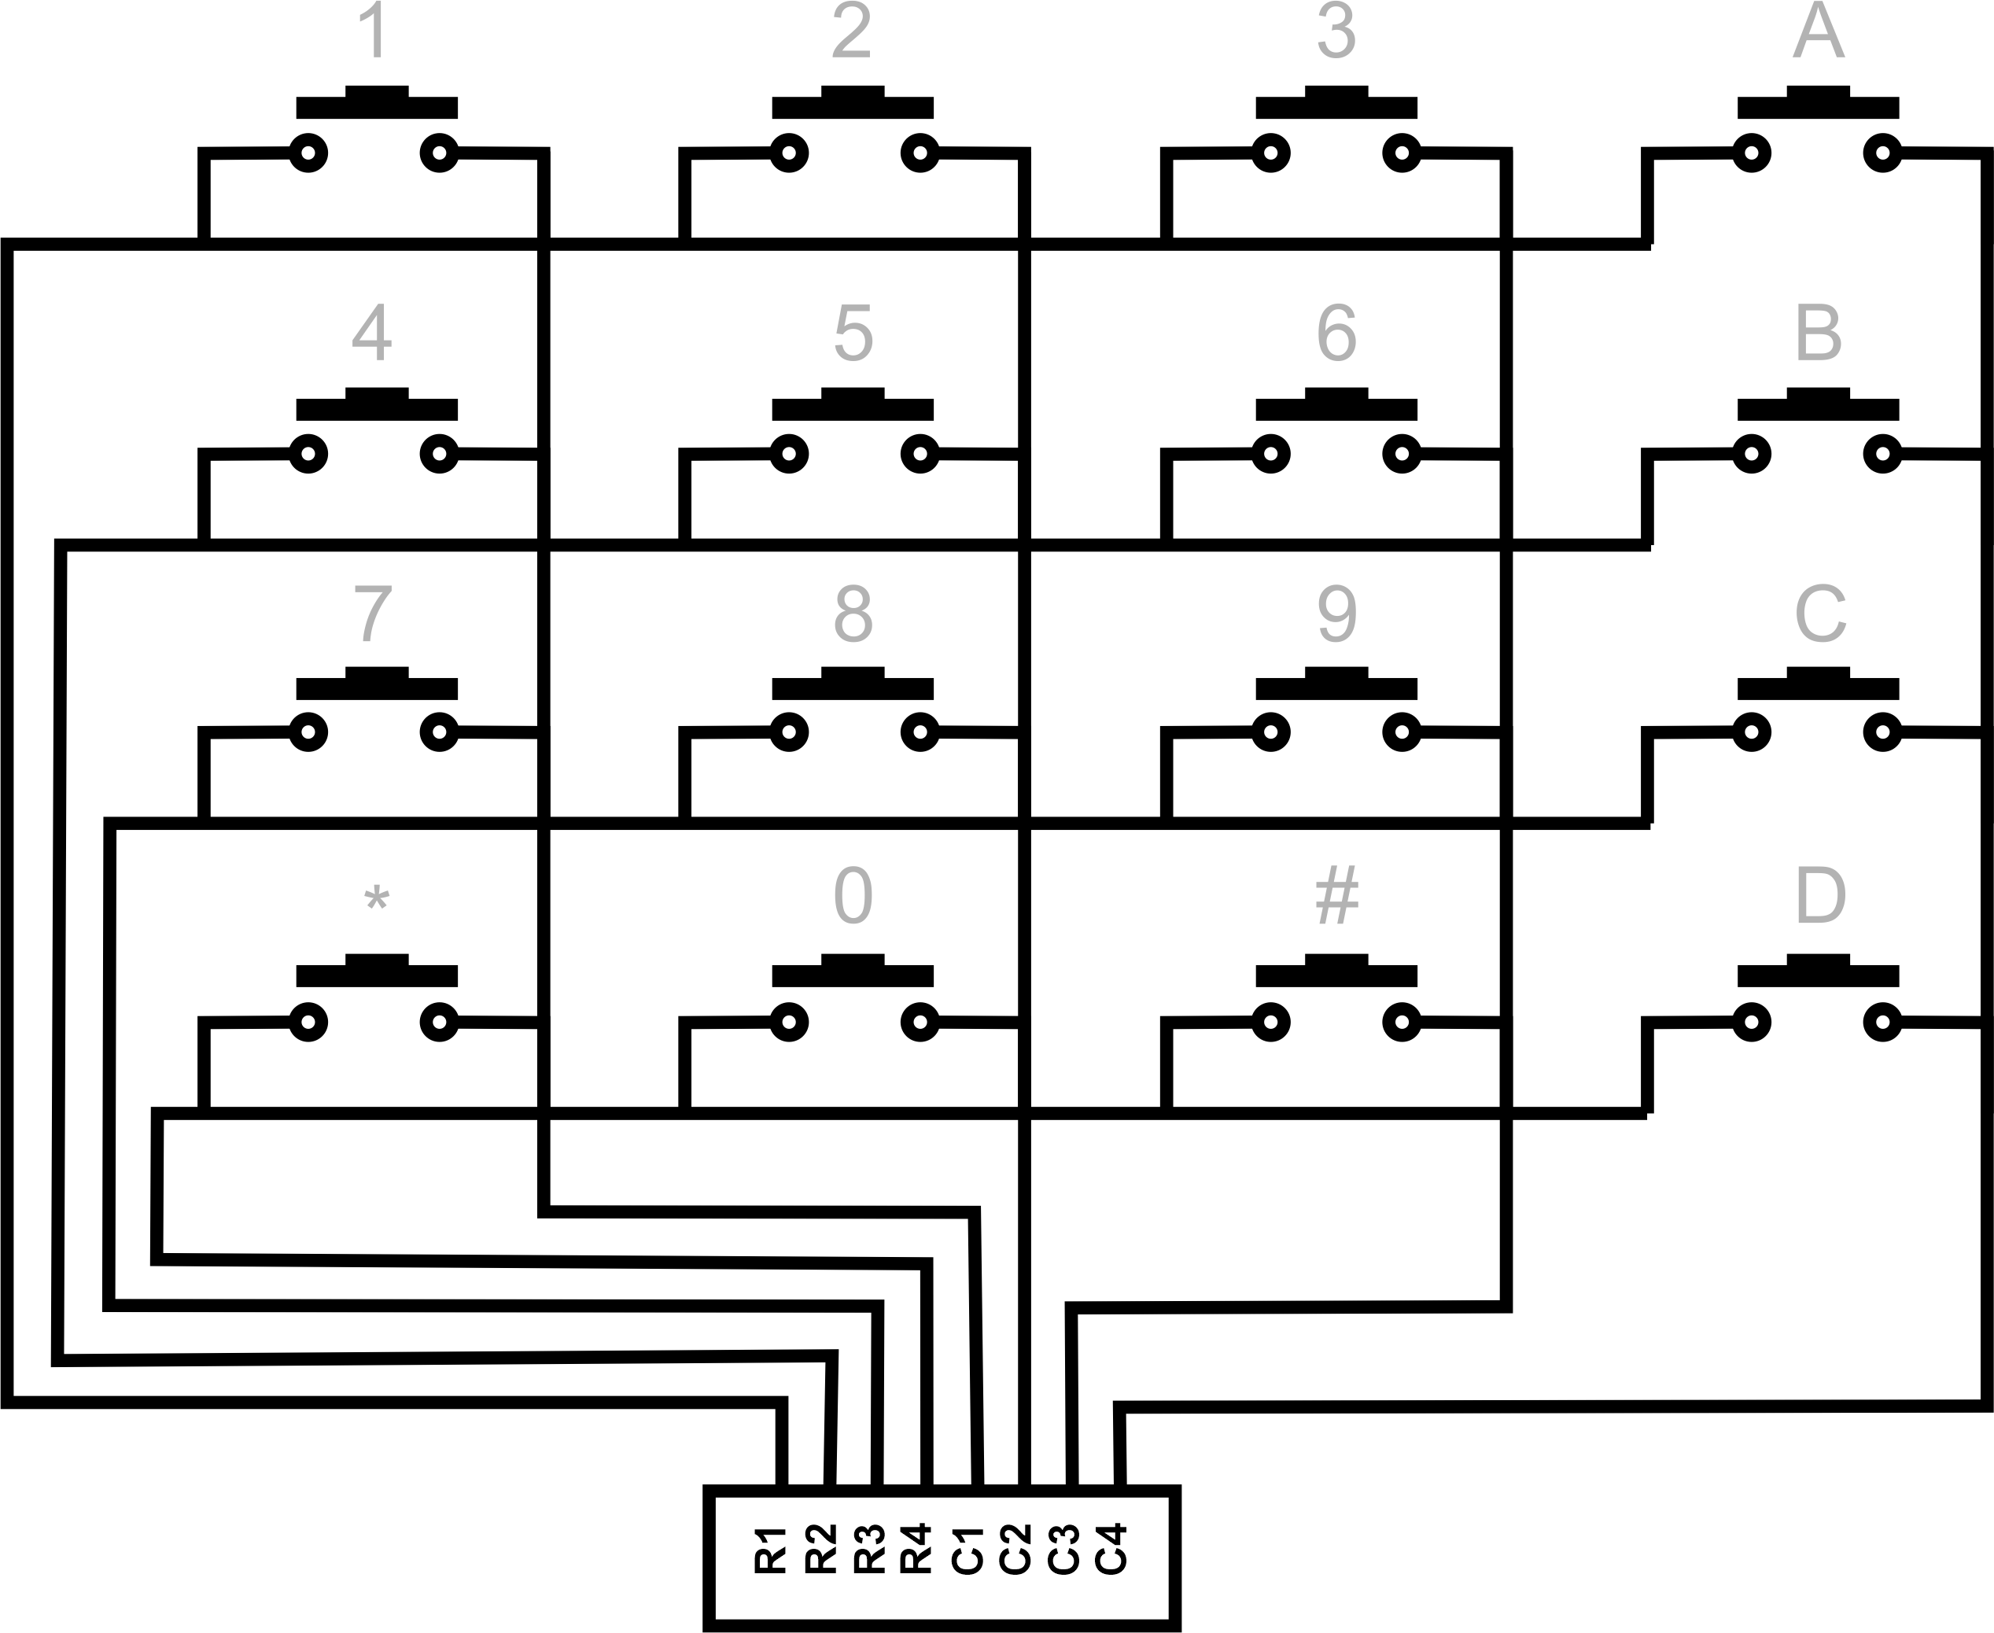

Slide 13
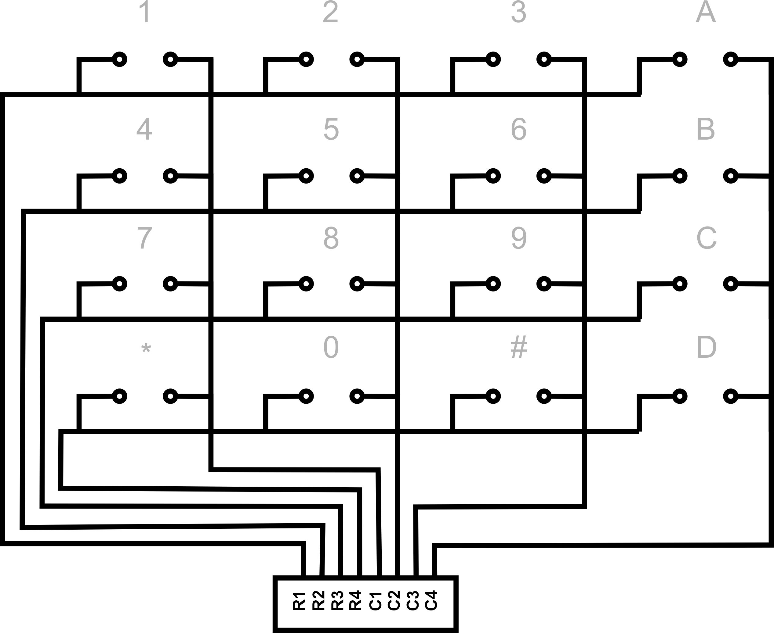

Slide 15
R1

Slide 16
R2

Slide 17
R3

Slide 18
R4

Slide 20


Slide 21
R3
C3

Slide 22
R3
C3
=
9

Slide 24
R2
C2

Slide 25
R3
C3
=
9
R2
C2
=
5

Slide 26
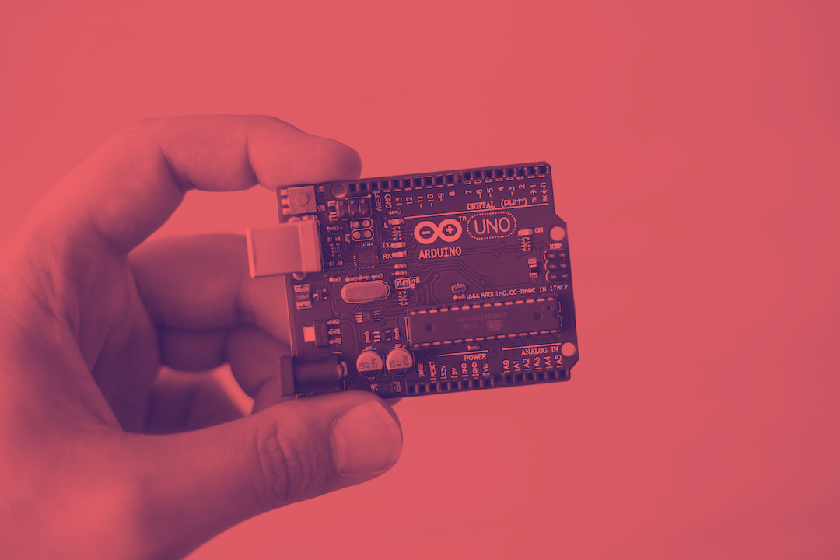
INSIDE THE KEYPAD
EXERCISES
APLIKASI MIKROKONTROLER
ERIL MOZEF, M. YUSUF FADHLAN

Slide 27
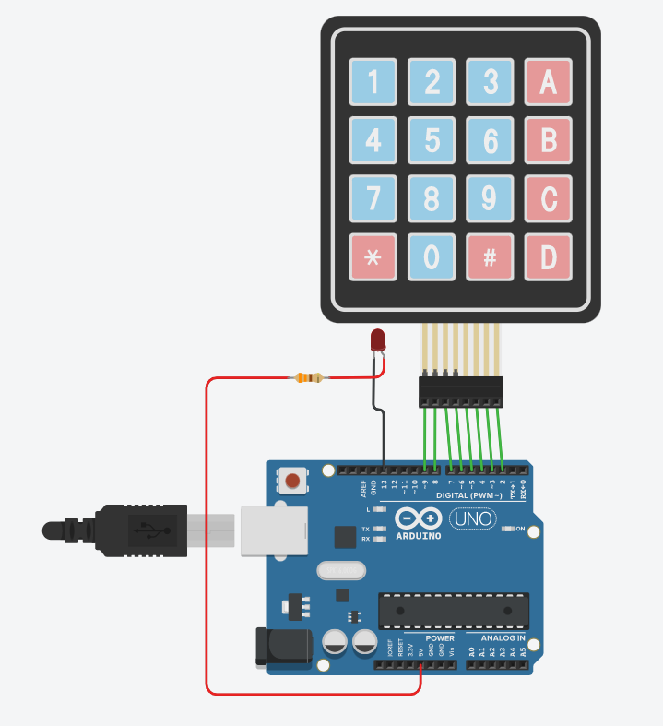
INSIDE THE KEYPAD
EXERCISES
APLIKASI MIKROKONTROLER
ERIL MOZEF, M. YUSUF FADHLAN

Slide 28
EXERCISES
APLIKASI MIKROKONTROLER
ERIL MOZEF, M. YUSUF FADHLAN

Slide 29
EXERCISES
#include<Keypad.h> // keypad library
const int numRows = 4; // jumlah row
const int numCols = 4; // jumlah coloum
char keymap [numRows][numCols]=
{
{'1','2','3',’*'},
{'4','5','6','B'},
{'7','8','9','C'},
{'*','0','#','D'}
};
byte rowPins[numRows] = {9,8,7,6}; // pin pada row
byte colPins[numCols] = {5,4,3,2}; // pin pada coloum
Keypad myKeypad = Keypad(makeKeymap(keymap),rowPins,colPins,numRows,numCols);
//class object
void setup()
{
pinMode(13,OUTPUT);
digitalWrite(13, HIGH);
}
void loop()
{
char keypressed =myKeypad.getKey();
//keypad adalah object dan .getKey() adalah method
if(keypressed=='1')
{
digitalWrite(13, LOW);
}
if(keypressed=='2')
{
digitalWrite(13, HIGH);
}
}

Slide 30

#include<Keypad.h> // keypad library
const int numRows = 4; // jumlah row
const int numCols = 4; // jumlah coloum
char keymap [numRows][numCols]=
{
{'1','2','3',’*'},
{'4','5','6','B'},
{'7','8','9','C'},
{'*','0','#','D'}
};
byte rowPins[numRows] = {9,8,7,6}; // pin pada row
byte colPins[numCols] = {5,4,3,2}; // pin pada coloum
Keypad myKeypad = Keypad(makeKeymap(keymap),rowPins,colPins,numRows,numCols);
//class object
void setup()
{
pinMode(13,OUTPUT);
digitalWrite(13, HIGH);
}
void loop()
{
char keypressed =myKeypad.getKey();
//keypad adalah object dan .getKey() adalah method
if(keypressed=='1')
{
digitalWrite(13, LOW);
}
if(keypressed=='2')
{
digitalWrite(13, HIGH);
}
}
EXERCISES
7SEGMENTS

Slide 31
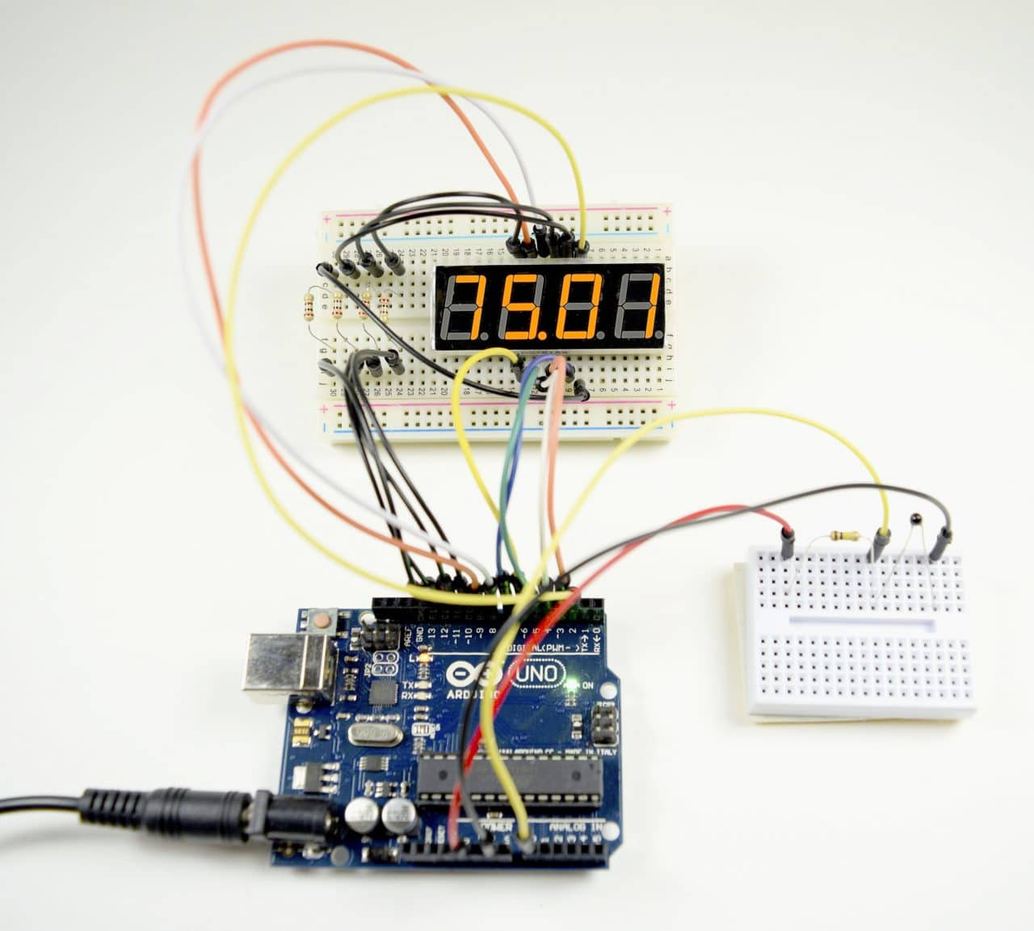
#include<Keypad.h> // keypad library
const int numRows = 4; // jumlah row
const int numCols = 4; // jumlah coloum
char keymap [numRows][numCols]=
{
{'1','2','3',’*'},
{'4','5','6','B'},
{'7','8','9','C'},
{'*','0','#','D'}
};
byte rowPins[numRows] = {9,8,7,6}; // pin pada row
byte colPins[numCols] = {5,4,3,2}; // pin pada coloum
Keypad myKeypad = Keypad(makeKeymap(keymap),rowPins,colPins,numRows,numCols);
//class object
void setup()
{
pinMode(13,OUTPUT);
digitalWrite(13, HIGH);
}
void loop()
{
char keypressed =myKeypad.getKey();
//keypad adalah object dan .getKey() adalah method
if(keypressed=='1')
{
digitalWrite(13, LOW);
}
if(keypressed=='2')
{
digitalWrite(13, HIGH);
}
}
EXERCISES
7SEGMENTS
APLIKASI MIKROKONTROLER
ERIL MOZEF, M. YUSUF FADHLAN

Slide 32
7SEGMENTS
APLIKASI MIKROKONTROLER
ERIL MOZEF, M. YUSUF FADHLAN

Slide 33
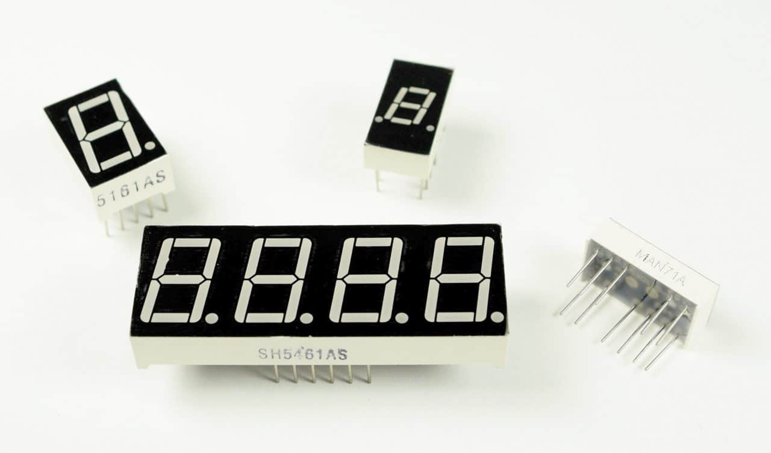
7SEGMENTS
APLIKASI MIKROKONTROLER
ERIL MOZEF, M. YUSUF FADHLAN

Slide 34
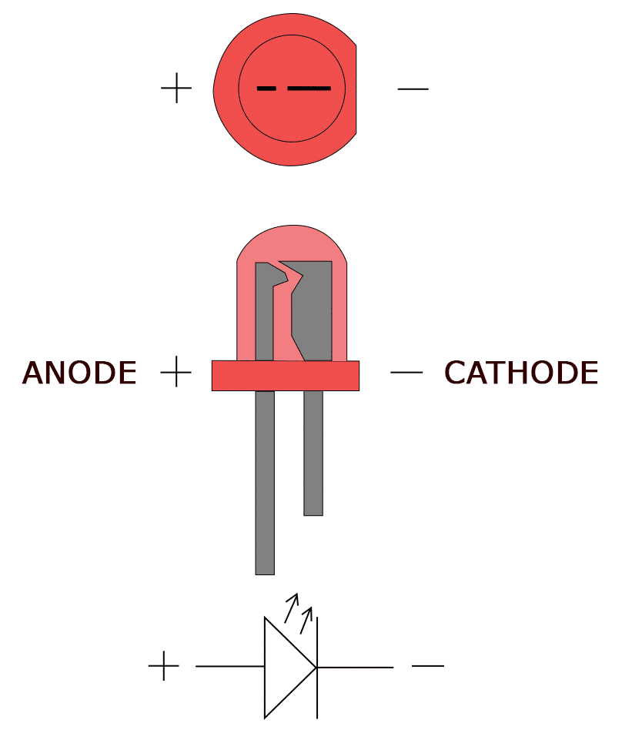
7SEGMENTS
A single LED consists of two terminals, an anode and a cathode. The anode is the positive terminal and the cathode is the negative terminal:
To power the LED, you connect the cathode to ground and the anode to the voltage supply. The LED can be turned on or off by switching power at the anode or the cathode.
APLIKASI MIKROKONTROLER
ERIL MOZEF, M. YUSUF FADHLAN

Slide 35
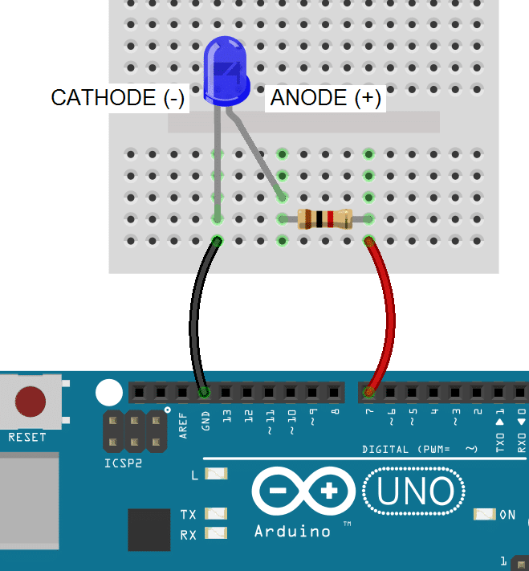
7SEGMENTS
With the LED’s anode connected to a digital pin, the cathode is connected to ground:
APLIKASI MIKROKONTROLER
ERIL MOZEF, M. YUSUF FADHLAN

Slide 36
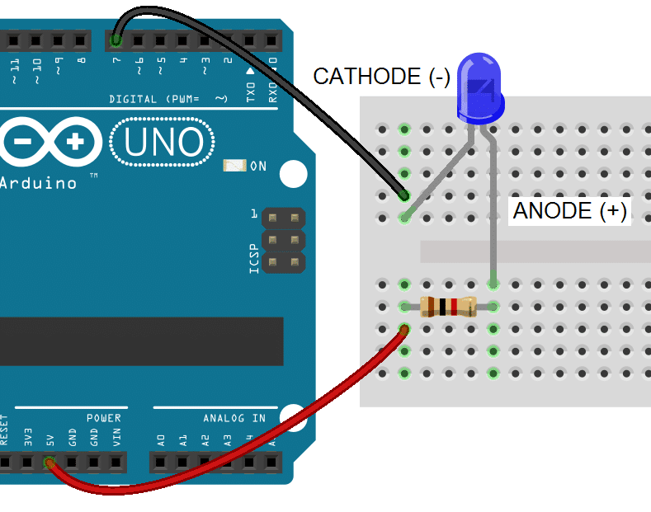
7SEGMENTS
With an LED’s cathode connected to a digital pin, the anode is connected to Vcc. To turn on the LED, the digital pin is switched LOW, which completes the circuit to ground:
APLIKASI MIKROKONTROLER
ERIL MOZEF, M. YUSUF FADHLAN

Slide 37
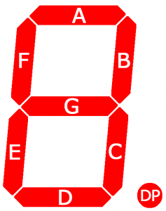
7SEGMENTS
Seven segment displays consist of 7 LEDs, called segments, arranged in the shape of an “8”. Most 7-segment displays actually have 8 segments, with a dot on the right side of the digit that serves as a decimal point. Each segment is named with a letter A to G, and DP for the decimal point:
Each segment on the display can be controlled individually, just like a regular LED.
There are two types of 7-segment displays – common cathode and common anode.
APLIKASI MIKROKONTROLER
myusuffadhlan
ERIL MOZEF, M. YUSUF FADHLAN

Slide 38
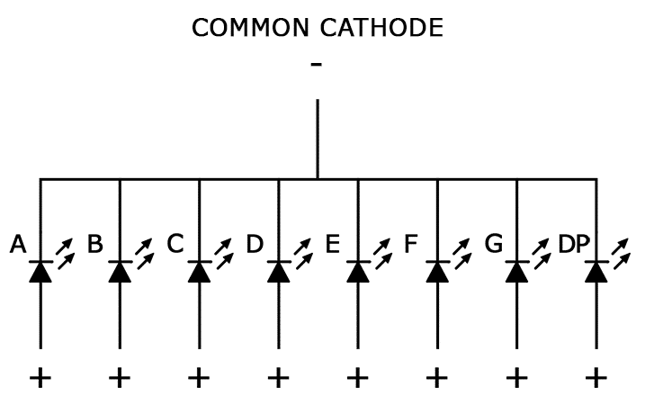
7SEGMENTS
APLIKASI MIKROKONTROLER
ERIL MOZEF, M. YUSUF FADHLAN

Slide 39
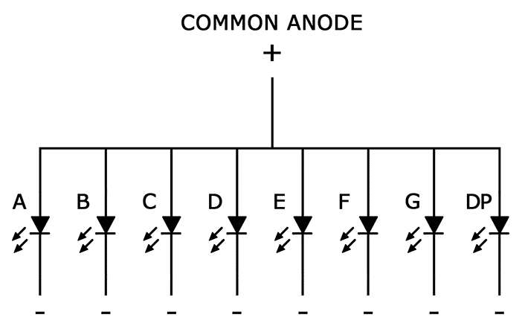
7SEGMENTS
APLIKASI MIKROKONTROLER
ERIL MOZEF, M. YUSUF FADHLAN

Slide 40
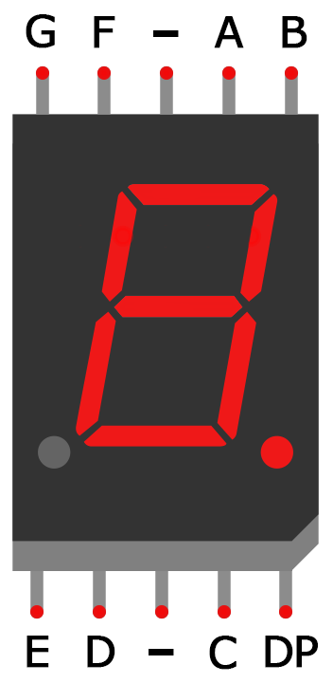
7SEGMENTS
APLIKASI MIKROKONTROLER
ERIL MOZEF, M. YUSUF FADHLAN

Slide 41
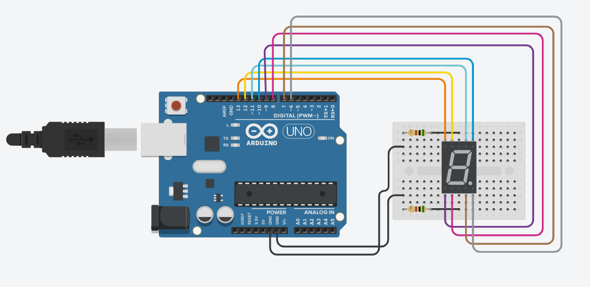
7SEGMENTS
APLIKASI MIKROKONTROLER
ERIL MOZEF, M. YUSUF FADHLAN

Slide 42
Soal 2
int A = 13;
int B = 12;
int C = 11;
int D = 10;
int E = 9;
int F = 8;
int G = 7;
int H = 6;
void setup(void)
{
pinMode(A, OUTPUT);
pinMode(B, OUTPUT);
pinMode(C, OUTPUT);
pinMode(D, OUTPUT);
pinMode(E, OUTPUT);
pinMode(F, OUTPUT);
pinMode(G, OUTPUT);
pinMode(H, OUTPUT);
}
void zero(void) {
digitalWrite(A, LOW);
digitalWrite(B, HIGH);
digitalWrite(C, HIGH);
digitalWrite(D, HIGH);
digitalWrite(E, HIGH);
digitalWrite(F, HIGH);
digitalWrite(G, HIGH);
digitalWrite(H, LOW);
}
void one(void) {
digitalWrite(A, LOW);
digitalWrite(B, LOW);
digitalWrite(C, LOW);
digitalWrite(D, HIGH);
digitalWrite(E, LOW);
digitalWrite(F, LOW);
digitalWrite(G, HIGH);
digitalWrite(H, LOW);
}
void two(void) {
digitalWrite(A, HIGH);
digitalWrite(B, LOW);
digitalWrite(C, HIGH);
digitalWrite(D, HIGH);
digitalWrite(E, HIGH);
digitalWrite(F, HIGH);
digitalWrite(G, LOW);
digitalWrite(H, LOW);
}
void three(void) {
digitalWrite(A, HIGH);
digitalWrite(B, LOW);
digitalWrite(C, HIGH);
digitalWrite(D, HIGH);
digitalWrite(E, LOW);
digitalWrite(F, HIGH);
digitalWrite(G, HIGH);
digitalWrite(H, LOW);
}
void four(void) {
digitalWrite(A, HIGH);
digitalWrite(B, HIGH);
digitalWrite(C, LOW);
digitalWrite(D, HIGH);
digitalWrite(E, LOW);
digitalWrite(F, LOW);
digitalWrite(G, HIGH);
digitalWrite(H, LOW);
}
void five(void) {
digitalWrite(A, HIGH);
digitalWrite(B, HIGH);
digitalWrite(C, HIGH);
digitalWrite(D, LOW);
digitalWrite(E, LOW);
digitalWrite(F, HIGH);
digitalWrite(G, HIGH);
digitalWrite(H, LOW);
}
void six(void) {
digitalWrite(A, HIGH);
digitalWrite(B, HIGH);
digitalWrite(C, HIGH);
digitalWrite(D, LOW);
digitalWrite(E, HIGH);
digitalWrite(F, HIGH);
digitalWrite(G, HIGH);
digitalWrite(H, LOW);
}
void seven(void) {
digitalWrite(A, LOW);
digitalWrite(B, LOW);
digitalWrite(C, HIGH);
digitalWrite(D, HIGH);
digitalWrite(E, LOW);
digitalWrite(F, LOW);
digitalWrite(G, HIGH);
digitalWrite(H, LOW);
}
void eight(void) {
digitalWrite(A, HIGH);
digitalWrite(B, HIGH);
digitalWrite(C, HIGH);
digitalWrite(D, HIGH);
digitalWrite(E, HIGH);
digitalWrite(F, HIGH);
digitalWrite(G, HIGH);
digitalWrite(H, LOW);
}
void nine(void) {
digitalWrite(A, HIGH);
digitalWrite(B, HIGH);
digitalWrite(C, HIGH);
digitalWrite(D, HIGH);
digitalWrite(E, LOW);
digitalWrite(F, HIGH);
digitalWrite(G, HIGH);
digitalWrite(H, LOW);
}
void loop(void)
{
zero();
}
Menggunakan Seven Segments sebagai output

Slide 43
Soal 2
int A = 13;
int B = 12;
int C = 11;
int D = 10;
int E = 9;
int F = 8;
int G = 7;
int H = 6;
void setup(void)
{
pinMode(A, OUTPUT);
pinMode(B, OUTPUT);
pinMode(C, OUTPUT);
pinMode(D, OUTPUT);
pinMode(E, OUTPUT);
pinMode(F, OUTPUT);
pinMode(G, OUTPUT);
pinMode(H, OUTPUT);
}
void zero(void) {
digitalWrite(A, LOW);
digitalWrite(B, HIGH);
digitalWrite(C, HIGH);
digitalWrite(D, HIGH);
digitalWrite(E, HIGH);
digitalWrite(F, HIGH);
digitalWrite(G, HIGH);
digitalWrite(H, LOW);
}
void one(void) {
digitalWrite(A, LOW);
digitalWrite(B, LOW);
digitalWrite(C, LOW);
digitalWrite(D, HIGH);
digitalWrite(E, LOW);
digitalWrite(F, LOW);
digitalWrite(G, HIGH);
digitalWrite(H, LOW);
}
void two(void) {
digitalWrite(A, HIGH);
digitalWrite(B, LOW);
digitalWrite(C, HIGH);
digitalWrite(D, HIGH);
digitalWrite(E, HIGH);
digitalWrite(F, HIGH);
digitalWrite(G, LOW);
digitalWrite(H, LOW);
}
void three(void) {
digitalWrite(A, HIGH);
digitalWrite(B, LOW);
digitalWrite(C, HIGH);
digitalWrite(D, HIGH);
digitalWrite(E, LOW);
digitalWrite(F, HIGH);
digitalWrite(G, HIGH);
digitalWrite(H, LOW);
}
void four(void) {
digitalWrite(A, HIGH);
digitalWrite(B, HIGH);
digitalWrite(C, LOW);
digitalWrite(D, HIGH);
digitalWrite(E, LOW);
digitalWrite(F, LOW);
digitalWrite(G, HIGH);
digitalWrite(H, LOW);
}
void five(void) {
digitalWrite(A, HIGH);
digitalWrite(B, HIGH);
digitalWrite(C, HIGH);
digitalWrite(D, LOW);
digitalWrite(E, LOW);
digitalWrite(F, HIGH);
digitalWrite(G, HIGH);
digitalWrite(H, LOW);
}
void six(void) {
digitalWrite(A, HIGH);
digitalWrite(B, HIGH);
digitalWrite(C, HIGH);
digitalWrite(D, LOW);
digitalWrite(E, HIGH);
digitalWrite(F, HIGH);
digitalWrite(G, HIGH);
digitalWrite(H, LOW);
}
void seven(void) {
digitalWrite(A, LOW);
digitalWrite(B, LOW);
digitalWrite(C, HIGH);
digitalWrite(D, HIGH);
digitalWrite(E, LOW);
digitalWrite(F, LOW);
digitalWrite(G, HIGH);
digitalWrite(H, LOW);
}
void eight(void) {
digitalWrite(A, HIGH);
digitalWrite(B, HIGH);
digitalWrite(C, HIGH);
digitalWrite(D, HIGH);
digitalWrite(E, HIGH);
digitalWrite(F, HIGH);
digitalWrite(G, HIGH);
digitalWrite(H, LOW);
}
void nine(void) {
digitalWrite(A, HIGH);
digitalWrite(B, HIGH);
digitalWrite(C, HIGH);
digitalWrite(D, HIGH);
digitalWrite(E, LOW);
digitalWrite(F, HIGH);
digitalWrite(G, HIGH);
digitalWrite(H, LOW);
}
void loop(void)
{
zero();
}
Menggunakan Seven Segments sebagai output

Slide 44
Soal 2
int A = 13;
int B = 12;
int C = 11;
int D = 10;
int E = 9;
int F = 8;
int G = 7;
int H = 6;
void setup(void)
{
pinMode(A, OUTPUT);
pinMode(B, OUTPUT);
pinMode(C, OUTPUT);
pinMode(D, OUTPUT);
pinMode(E, OUTPUT);
pinMode(F, OUTPUT);
pinMode(G, OUTPUT);
pinMode(H, OUTPUT);
}
void zero(void) {
digitalWrite(A, LOW);
digitalWrite(B, HIGH);
digitalWrite(C, HIGH);
digitalWrite(D, HIGH);
digitalWrite(E, HIGH);
digitalWrite(F, HIGH);
digitalWrite(G, HIGH);
digitalWrite(H, LOW);
}
void one(void) {
digitalWrite(A, LOW);
digitalWrite(B, LOW);
digitalWrite(C, LOW);
digitalWrite(D, HIGH);
digitalWrite(E, LOW);
digitalWrite(F, LOW);
digitalWrite(G, HIGH);
digitalWrite(H, LOW);
}
void two(void) {
digitalWrite(A, HIGH);
digitalWrite(B, LOW);
digitalWrite(C, HIGH);
digitalWrite(D, HIGH);
digitalWrite(E, HIGH);
digitalWrite(F, HIGH);
digitalWrite(G, LOW);
digitalWrite(H, LOW);
}
void three(void) {
digitalWrite(A, HIGH);
digitalWrite(B, LOW);
digitalWrite(C, HIGH);
digitalWrite(D, HIGH);
digitalWrite(E, LOW);
digitalWrite(F, HIGH);
digitalWrite(G, HIGH);
digitalWrite(H, LOW);
}
void four(void) {
digitalWrite(A, HIGH);
digitalWrite(B, HIGH);
digitalWrite(C, LOW);
digitalWrite(D, HIGH);
digitalWrite(E, LOW);
digitalWrite(F, LOW);
digitalWrite(G, HIGH);
digitalWrite(H, LOW);
}
void five(void) {
digitalWrite(A, HIGH);
digitalWrite(B, HIGH);
digitalWrite(C, HIGH);
digitalWrite(D, LOW);
digitalWrite(E, LOW);
digitalWrite(F, HIGH);
digitalWrite(G, HIGH);
digitalWrite(H, LOW);
}
void six(void) {
digitalWrite(A, HIGH);
digitalWrite(B, HIGH);
digitalWrite(C, HIGH);
digitalWrite(D, LOW);
digitalWrite(E, HIGH);
digitalWrite(F, HIGH);
digitalWrite(G, HIGH);
digitalWrite(H, LOW);
}
void seven(void) {
digitalWrite(A, LOW);
digitalWrite(B, LOW);
digitalWrite(C, HIGH);
digitalWrite(D, HIGH);
digitalWrite(E, LOW);
digitalWrite(F, LOW);
digitalWrite(G, HIGH);
digitalWrite(H, LOW);
}
void eight(void) {
digitalWrite(A, HIGH);
digitalWrite(B, HIGH);
digitalWrite(C, HIGH);
digitalWrite(D, HIGH);
digitalWrite(E, HIGH);
digitalWrite(F, HIGH);
digitalWrite(G, HIGH);
digitalWrite(H, LOW);
}
void nine(void) {
digitalWrite(A, HIGH);
digitalWrite(B, HIGH);
digitalWrite(C, HIGH);
digitalWrite(D, HIGH);
digitalWrite(E, LOW);
digitalWrite(F, HIGH);
digitalWrite(G, HIGH);
digitalWrite(H, LOW);
}
void loop(void)
{
zero();
}
Menggunakan Seven Segments sebagai output

Slide 45

7SEGMENTS
LCD
APLIKASI MIKROKONTROLER
ERIL MOZEF, M. YUSUF FADHLAN

Slide 46
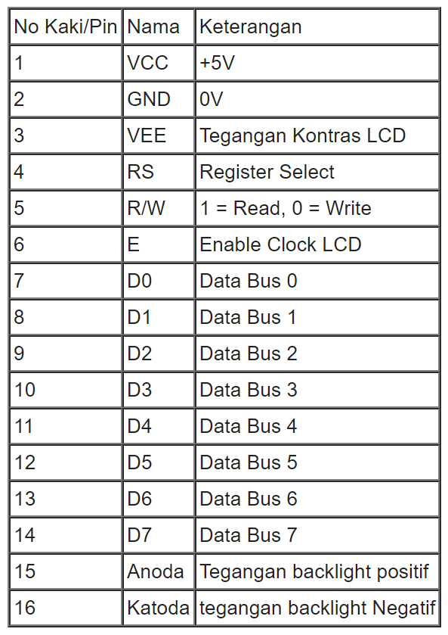
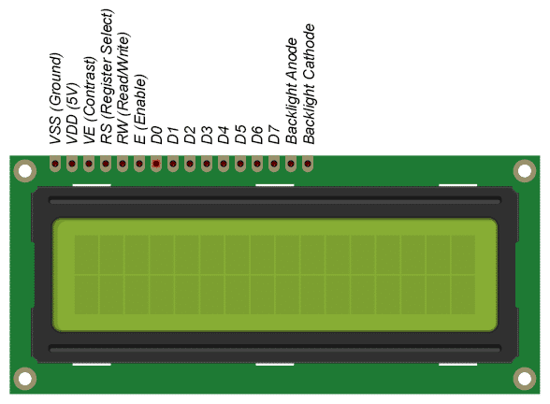
7SEGMENTS
LCD
APLIKASI MIKROKONTROLER
ERIL MOZEF, M. YUSUF FADHLAN

Slide 47
LCD
APLIKASI MIKROKONTROLER
myusuffadhlan
ERIL MOZEF, M. YUSUF FADHLAN
PIN diagram and registers of 16x2 LCD (includehelp.com)

Slide 48
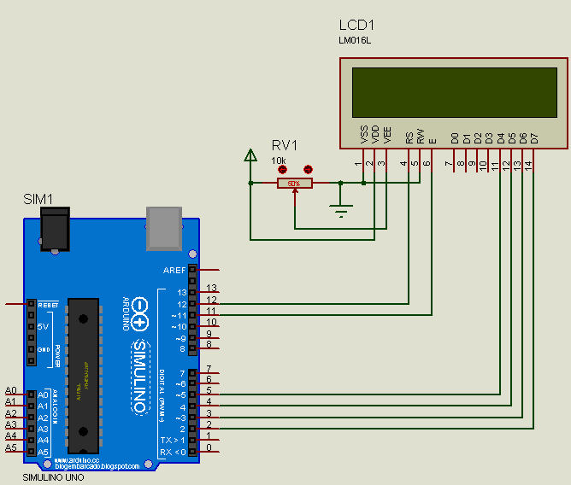
LCD
APLIKASI MIKROKONTROLER
ERIL MOZEF, M. YUSUF FADHLAN

Slide 49
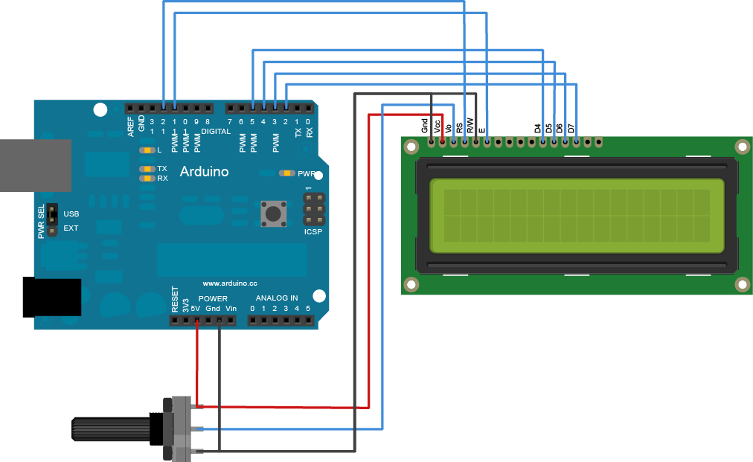
LCD
APLIKASI MIKROKONTROLER
ERIL MOZEF, M. YUSUF FADHLAN

Slide 50
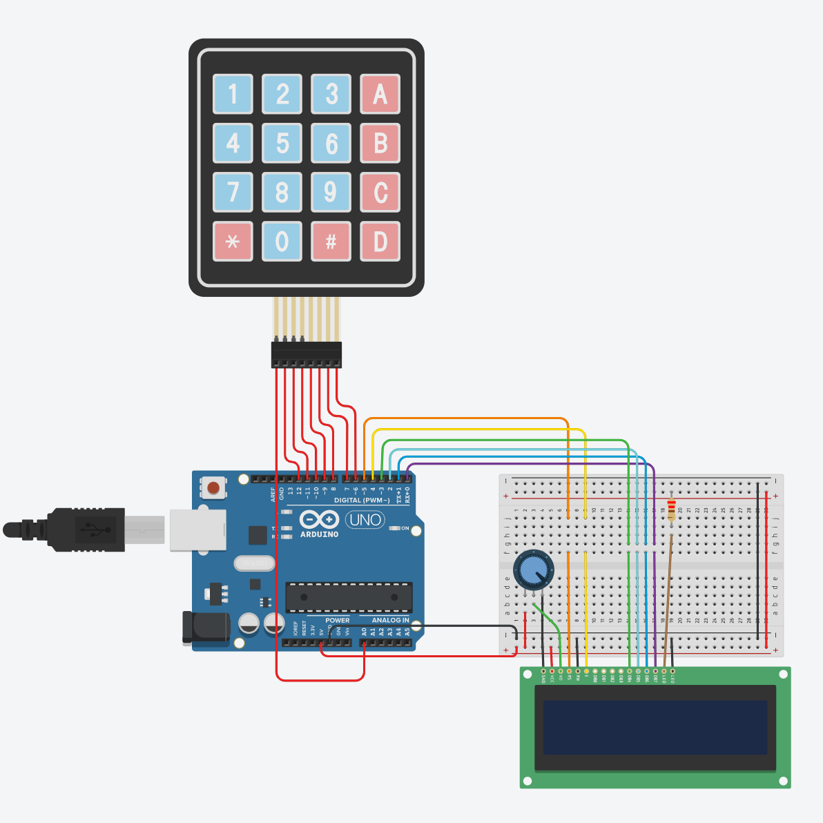
LCD
APLIKASI MIKROKONTROLER
ERIL MOZEF, M. YUSUF FADHLAN

Slide 51
LCD
The resistor in the diagram above sets the backlight brightness. A typical value is 220 Ohms, but other values will work too. Smaller resistors will make the backlight brighter.
The potentiometer is used to adjust the screen contrast. I typically use a 10K Ohm potentiometer, but other values will also work.

Slide 52
LCD
#include <LiquidCrystal.h>
// library LCD
#include<Keypad.h>
// library keypad
const int numRows = 4;
const int numCols = 4;
char keymap [numRows][numCols]=
{
{'1','2','3','A'},
{'4','5','6','B'},
{'7','8','9','C'},
{'*','0','#','D'}
};
byte rowPins[numRows] = {A0,12,11,10};
byte colPins[numCols] = {9,8,7,6};
Keypad keypad = Keypad(makeKeymap(keymap),rowPins,colPins,numRows,numCols);
//Class object
LiquidCrystal lcd(5, 4, 3, 2, 1, 0);
int LCDrow = 0;
void setup()
{
// melakukan setting LCD:
lcd.begin(16, 2);
lcd.setCursor(LCDrow, 0);
lcd.print("Aplikasi Arduino");
lcd.setCursor(LCDrow, 1);
lcd.print("Politeknik Negeri Bandung");
delay (3000);
lcd.clear();
lcd.setCursor(LCDrow, 0);
}
void loop()
{
char key = keypad.getKey();
if (key)
{
Serial.println(key);
lcd.print(key);
lcd.setCursor (++LCDrow, 0);
}
}

Slide 53
#include <LiquidCrystal.h>
// library LCD
#include<Keypad.h>
// library keypad
const int numRows = 4;
const int numCols = 4;
char keymap [numRows][numCols]=
{
{'1','2','3','A'},
{'4','5','6','B'},
{'7','8','9','C'},
{'*','0','#','D'}
};
byte rowPins[numRows] = {A0,12,11,10};
byte colPins[numCols] = {9,8,7,6};
Keypad keypad = Keypad(makeKeymap(keymap),rowPins,colPins,numRows,numCols);
//Class object
LiquidCrystal lcd(5, 4, 3, 2, 1, 0);
int LCDrow = 0;
void setup()
{
// melakukan setting LCD:
lcd.begin(16, 2);
lcd.setCursor(LCDrow, 0);
lcd.print("Aplikasi Arduino");
lcd.setCursor(LCDrow, 1);
lcd.print("Politeknik Negeri Bandung");
delay (3000);
lcd.clear();
lcd.setCursor(LCDrow, 0);
}
void loop()
{
char key = keypad.getKey();
if (key)
{
Serial.println(key);
lcd.print(key);
lcd.setCursor (++LCDrow, 0);
}
}
LCD

